Slide 1


SAP FINANCIALS Validations & Substitutions
This presentation is for internal use only and not intended for external distribution. Its contents must be held in confidence.

Slide 2

COURSE OBJECTIVES
Explain the ways in which validation and substitution can be used using a few examples
Identify the areas of application and call up points of validation and substitution in Financial Accounting
Enter rules and define the Customizing of system messages to be output (prerequisites, check, generation)
Execute validations using your own rules and defined system messages
Provide the prerequisites for substitution
Define your own rules, specify substituted values and execute substitutions
Explain how to use rules, sets and use them

Slide 3
CONTENTS
Basics of Validations/substitutions
Validations in Financial Accounting
Substitutions in Financial Accounting
Rules and Sets

Slide 4
CONTENTS
Basics of Validations/substitutions
Validations in Financial Accounting
Substitutions in Financial Accounting
Rules and Sets

Slide 5
Basics of Validations/Substitutions
Objective:
After the lesson you will be able to:
Define Validations and Substitutions
Executing Validations and Substitutions
Application areas and Call up points
Formulae editor
Assignments and activation
Transactions codes: Validation – OB28 / GGB0.
Substitution – OBBH / GGB1.

Slide 6
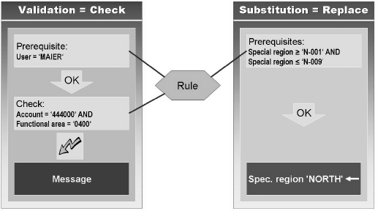
Meaning of Validations & Substitutions
Validations
The validation function helps you to check the entered values and value intervals. If the values are not as per rule, it shows message/error/information.
When data are entered in the system, the Rule Manager validates the data according to the validation rules.
Substitutions
Values entered into the SAP system are validated according to a prerequisite defined by the user. If the prerequisite is met, the system replaces the values entered with other values.
You define these using Boolean’s logic

Slide 7
Steps to execute Validation/Substitution
You must decide for which area of application validation/substitution should apply.(Examples: FI, CO, AM, PC etc.)
The correct callup point for the validation/substitution must be selected. There are three call up points are specified.
Document header
Document line item
Complete document
The validation/substitution must be defined.
Area of application and the call up point can be used for your validation/substitution are specified.
4. You must assign your validation/substitution to an appropriate organizational unit (e.g. company code for Financial Accounting, company code or company for FI-SL, controlling area for CO)
5. Activate it.

Slide 8
Callup points
Document header fields can be validated at callup point 1.
Example: If posting date <> document date then issue warning message.
Document line item fields can be validated in callup point 2.
Example: For G/L account 400000 business area to be used is 0001. If not error message.
NOTE: The fields that are available for callup point 1 are also available in callup
point 2 for possible cross-validations.
Example: Only certain accounts can be used for selected document types.
At the Complete document callup point, you can use only those numeric fields with which you can primarily execute mathematical calculations.
You can use the following operators to work in callup point 3.
- SUM (), AVG (), MAX () etc.

Slide 9
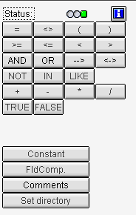

Formula editor
The Formula Editor provides a user-friendly interface for entering arithmetic and logical statements.
The entry undergoes a step-by-step inspection for the correctness of the syntax.
The system permits only syntactically correct statements to be entered; as a result, no errors occur when entering rules.
You can work with
Short descriptions
Technical names
Expert mode: Where you can define the formula freely.

Slide 10
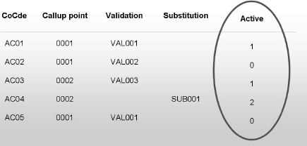
Assignment and Activation
You must assign your validation/substitution to an appropriate organizational unit. Ex: FI – company code, CO – Controlling area etc.
A validation/substitution can be valid for several company codes at the same time.
Only one validation/substitution can be activated for one company code for a callup point.ame time.
0 – Inactive
1 – Active for dialog and batch
2 – Active except for batch input

Slide 11
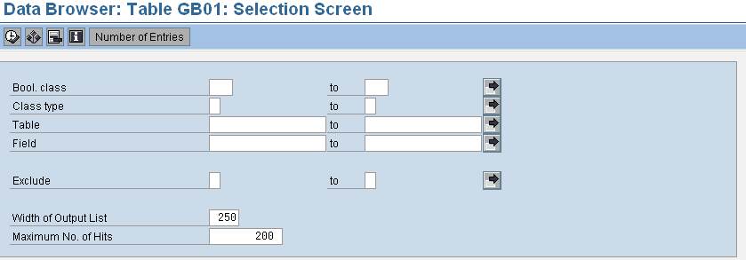
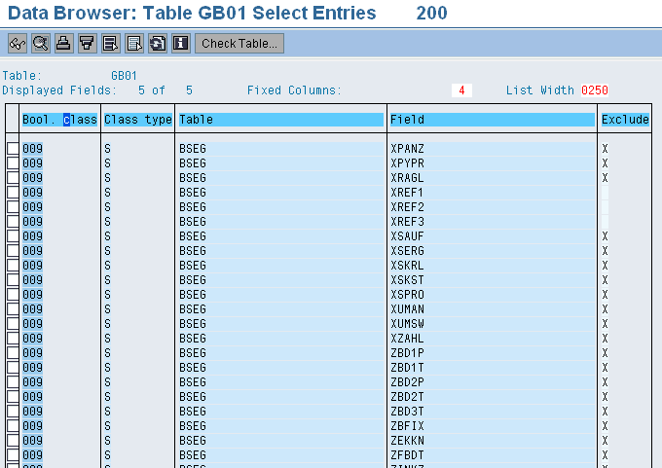
Preventing the Fields from Being Used
To prevent any Filed from being used that case Table GB01 can be used.
By Using Exclude indicator we can filed in the table can be limited.
Notes:
The Explanation of the table GB01 and there contains as follow.
Bool Class: The Boolean Classes Specifies where the filed is being used or is Excluded.
Class Rules: Defines whether this field is used for field Read or field Write. Write is used in substitution, read for rules.
Table name that can be used in this class. Name of a table that belongs to this class
Field that belongs to this class Name of a field that belongs to this class.

Slide 12

Basics of Validations/Substitutions
Summary:
Now you should be able to:
Define Validations and Substitutions
Executing Validations and Substitutions
Application areas and Call up points
Formulae editor
Assignments and activation

Slide 13
CONTENTS
Basics of Validations/substitutions
Validations in Financial Accounting
Substitutions in Financial Accounting
Rules and Sets

Slide 14
Validations in Financial Accounting
Objective:
After the lesson you will be able to understand:
Validation Procedure
Messages
Field comparisons

Slide 15
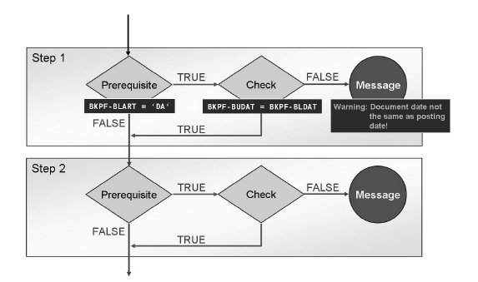
Validation Procedure
Validation consists of several steps (max of 999).
Each step has three parts
Prerequisite
Check
Message
If the prerequisite statement is satisfied (TRUE), a check is performed. If the result of the check is (FALSE), the system posts a message.
Example: In certain invoices, the document date is to be compared with the posting data and, if the dates are not the same, a warning is to be issued.
Click to view
SAP SCREEN

Slide 16
Validation Messages
You can use a predefined message or create a new message for validation.
Messages can have different meanings:
I = Information
W = Warning
E = Error (requires that the entry be corrected)
A = Cancel
Example of a validation step
Prerequisite: BSEG-KUNNR= “0010002801” (G/L account number)
Check: BKPF-BLART = “EC” (Document Type)
Message:
Error message You MUST use document type EC with Euro-control transactions!.
(error message created)
Note: In validations “&” is used as a wildcard.
Click to view
SAP SCREEN

Slide 17
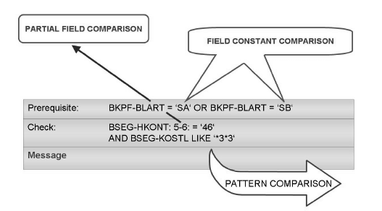
Field Comparisons
Using Boolean Logic, you can define different types of logical statements.
Following in logical statements:
Partial field comparison:
Only a part of field can be compared.
Example: BSEG-HKONT :3:
The system checks only the third digit of the field
Example: BSEG-HKONT :1-3:
The system checks only the first three digits of the field
Example: BSEG-HKONT: 3-:
The system checks from digit 3 to the end of field
(Above all checks if the condition is true or false)
Compare fields with one another:
BKPF-BUDAT <> BKPF-BLDAT
Validate field contents for certain values:
BKPF-BLART = ‘SA‘
Compare text patterns in your statements using the LIKE keyword.
Example: BSEG-KOSTL LIKE .*3*3.
(for example, 363, 323, and 2303).

Slide 18
Validation Configuration (T Code: OB28)
Path: SAP Reference IMG → Financial Accounting → Financial Accounting Global Setting → Document → Line Item → Define Validations for Posting → Environment → Validation
While posting values to the Gl A/c '0010002801‘ an Document type should be EC only.
Following steps need to execute .
Define the step and set the Prerequisite.
Check the Validation ( value on which validation can be done)
Insert the Message which should reflect incase condition doesn't get fulfill.
Step-1
Prerequisite defined as
BSEG-KUNNR = '0010002801'
Notes:
System will check, If the General Ledger Account Number: “0010002801”, Document type should be “EC”. If not system will through the Error message as shown above – “You MUST use document type EC with Euro-control transactions!”.

Slide 19
Validation Configuration (T Code: OB28) Cont…
Meaning:
GL Account No:'0010002801‘
Step-2
Define the Validation Check.
BKPF-BLART = 'EC'
Meaning:- Document type = “EC”
Step-3
Incase condition doesn't fulfilled then system should pop-up the Message.
“You MUST use document type EC with Euro-control transactions!”
Notes:
System will check, If the General Ledger Account Number: “0010002801”, Document type should be “EC”. If not system will through the Error message as shown above – “You MUST use document type EC with Euro-control transactions!”.

Slide 20
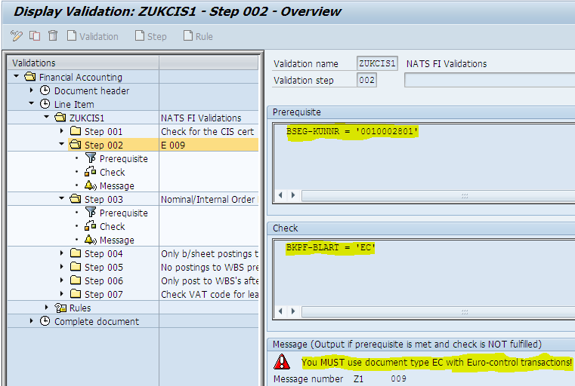
Validation Configuration (T Code: OB28) Cont…
Notes:
System will check, If the General Ledger Account Number: “0010002801”, Document type should be “EC”. If not system will through the Error message as shown above – “You MUST use document type EC with Euro-control transactions!”.

Slide 21
Validation Configuration (T Code: OB28) Cont…
If the Validation is more complex nature, better go for the User Exit option.
User Exit will be developed with the help of ABAP team and assigned at Validation – Check place, to perform the given validation check.

Slide 22
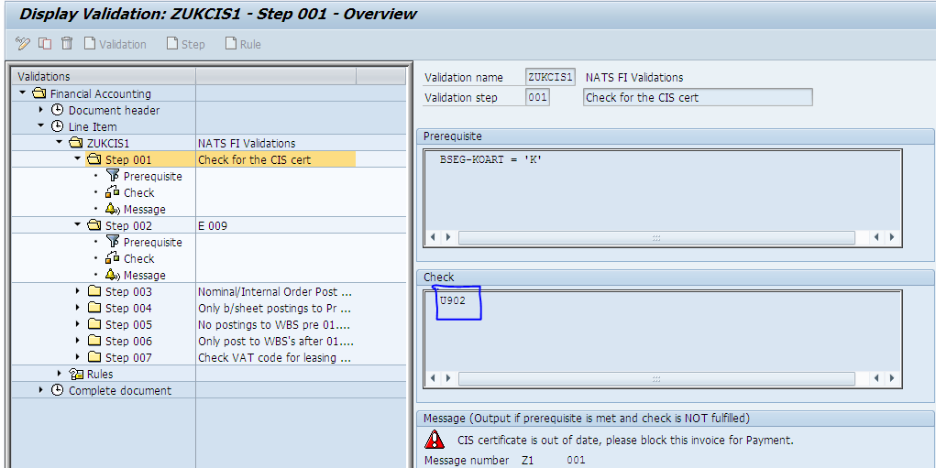
Validation Configuration (T Code: OB28) Cont…

Slide 23
Validations in Financial Accounting
Summary:
Now you should be able to understand :
Validation Procedure
Messages
Field Comparisons

Slide 24
CONTENTS
Basics of Validations/substitutions
Validations in Financial Accounting
Substitutions in Financial Accounting
Rules and Sets

Slide 25
Substitutions in Financial Accounting
Objective:
After the lesson you will be able to understand:
Substitution Procedure
Methods of Substitution

Slide 26
Meaning and Substitution Procedure
During document entry, the system sometimes automatically determines values for fields from values that were entered for other fields, such as the business area or the profit center due to a assigned cost center or an internal order.
Substitution consists of several steps (max of 999).
Each step has two parts
Prerequisite
Replacement
If the prerequisite is satisfied (TRUE), substitution is performed.
Example: The Functional area field is to be filled depending on the type of cost center.
Prerequisite
Statement
Click to view
SAP SCREEN
true
false
Perform
substitution
Do not Perform
substitution

Slide 27
Substitution Methods
For each of the fields you selected, a dialog box appears in which you can define the substitution method. You can choose between:
Constant value
If the prerequisite is true the field mentioned is filled with a constant value given.
Example: If the Co. Code is “0001” The Profit Center will be substituted with “0000000001” even if the user enters the different Profit Center system will replaced in the field Profit Center and Business Area.
User Exits
If the prerequisite is true, an user exit (program) is carried out at runtime.
Example: If the prerequisite is true then run the program “ZXXXX”.
Field-field assignment
If the prerequisite is true, the system substitutes the contents of the field with the contents of the source field.
Example: Field Assignment (usually contains clearing information) is replaced by the contents of field Business area if certain prerequisites are satisfied.
Click to view
SAP SCREEN
Notes:
As like Validations, if the Substitution is complex nature, we can meet the object by using the User Exit.

Slide 28
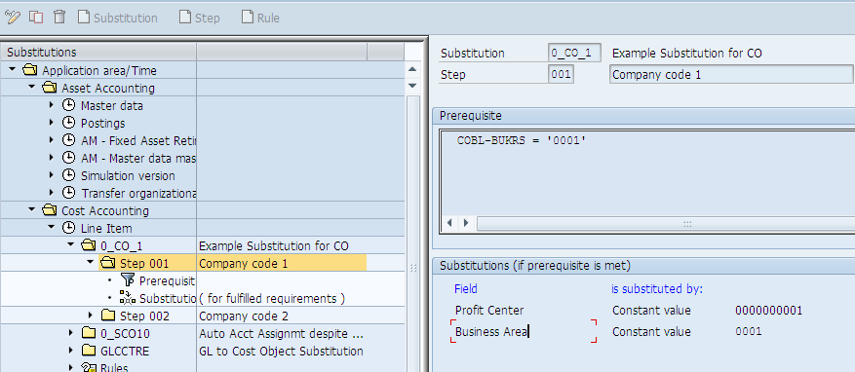
Substitution Methods
Click to view
SAP SCREEN
Notes:
As like Validations, if the Substitution is complex nature, we can meet the object by using the User Exit.

Slide 29
Substitutions in Financial Accounting
Summary:
Now you should be able to understand :
Substitution Procedure
Methods of Substitution

Slide 30
CONTENTS
Basics of Validations/substitutions
Validations in Financial Accounting
Substitutions in Financial Accounting
Rules and Sets

Slide 31
Rules and Sets
Objective:
After the lesson you will be able to:
Define Rules and use it.
Define Sets and use it.

Slide 32
Rules
Sometimes, more detailed rules as well as more extensive processing are required to enter your logical statements in prerequisites and checks, as well as for the specification of the values to be used. For this reason, you can use rules and sets to define your validations/substitutions.
A rule is a logical statement that you can use in a prerequisite statement, a check, or another rule.
A rule permits complex logic to be summarized; it can be re-used.
CONTENT
(BKPF-USNAM = ‘MEIER’ OR BKPF-USNAM = ‘MUELLER’) AND (BSEG-HKONT >=‘101000’ AND BSEG-HKONT <=‘101009’)
RULE NAME: GROUP ACCOUNT
Prerequisites: GROUP ACCOUNT AND BKPF-BLART = ‘SB’
Check: BSEG-GSBER<=‘3000’
Message:

Slide 33
Sets
USER GROUP
ACCOUNT MANAGEMENT
001 – 43000
001 – RAVI
002 – HARI
003 – GIRI
004 - SURI
002 – 43200
003 – 43300
004 - 43400
Basic set
Basic set
Table BKPF field USNAM
Table BSEG field HKONT
Prerequisite: BKPF-USNAM in USER GROUP
Check: BSEG-HKONT in ACCOUNT MANAGEMENT
A set is a flexible data structure for portraying arranged amounts and hierarchies.
Sets are maintained and administrated centrally.
Syntax rule: table name - field name IN set name
You can use multi-dimension sets (a combination of sets for various fields [dimensions]) to execute cross-validation with values of different characteristics.

Slide 34
Menu Paths
VALIDATIONS
SAP Reference IMG → Financial Accounting→ Financial Accounting Global Settings → Document → Line Item → Define Validations for Posting → Environment → Validation.
SUBSTITUTIONS
SAP Reference IMG → Financial Accounting → Financial Accounting Global Settings → Document → Line Item → Define Substitution in Accounting Documents → Environment → Substitution.
SETS
SAP Easy Access → Accounting → Financial Accounting → Special Purpose Ledger → Tools → Set Maintenance → Sets → Create.
T.Codes: Validation - GGB0, Substitution - GGB1, Set: GS01 (Creation), GS02 (Change), GS03 (Display).

Slide 35
Rules and Sets
Summary:
Now you should be able to:
Define Rules and use it.
Define Sets and use it.

Slide 36
Validations and Substitutions: Exercise Time
Each step has how many parts what are they (both in validation and substitution)?
Maximum number of steps in validation/substitutions?
Number of substitution methods and what are they?
Syntax rule for SET? (WHERE/IN)
For Practice (in company code 1000)
For your vendor invoice, you must ensure that only the telephone cost center (T-A20F) is entered for the telephoning expenses (account 473110 or 473120). If you assign an incorrect cost center, you should receive an error message (E): Please assign only cost center T-A20F for account &!. (& is a wildcard for the account to be output.)
For your customer invoice, you must ensure that Profit Center PC00 be substituted when a certain revenue account (810201 or 810301) [BSEG-HKONT], combined with a special region (N-001 or S-001) [BSEG-ZZSPREG], is entered.
If the user enters a certain revenue account (810201, 810301 or 810401) with a certain material number (T-IC-R2007, T-IC-R2008 or T-IC-R2009), profit center PC01 is to be substituted.

Slide 37
COURSE SUMMARY
Explain the ways in which validation and substitution can be used using a few examples
Identify the areas of application and callup points of validation and substitution in Financial Accounting
Enter rules and define the Customizing of system messages to be output (prerequisites, check, generation)
Execute validations using your own rules and defined system messages
Provide the prerequisites for substitution
Define your own rules, specify substituted values and execute substitutions
Explain how to use rules and use them
Explain how to use sets and use them

